Slide 1
Microsoft security user group
Welcome to MSUG-one year anniversary & Build afterparty!

Slide 2

Agenda
Welcome!
Identity, Security, and Compliance updates from Microsoft Build 2023
AI and LLM - How can we use it for offensive and defensive Security?
Kahoot
Panel discussion

Slide 3


_December Meetup | TBD_
TBD.Dec ‘23
If you are interested in presenting a topic send over a session request to us in sessionize!
JAN
DEC
FEB
NOV
MAR
_October Meetup | TBD_
TBD.Oct ‘23
_DevSecOps | CTF
30.May ‘23
OCT
APR
SEP
_Annual Wheel_ 2023
MAY
_Azure Governance_
TBD.Aug ‘23
AUG
_MSUG Anniversary | AI Edition_
30.May ‘23
JUL
JUN
_Summer Vacation_
Jul ‘23
_Identity & SaaS apps w/ Sentinel_
TBD.Jun ‘23

Slide 4
Microsoft Build security updates
Entra External ID
Copilot & Azure AI
Win32 App Isolation
Other

Slide 5
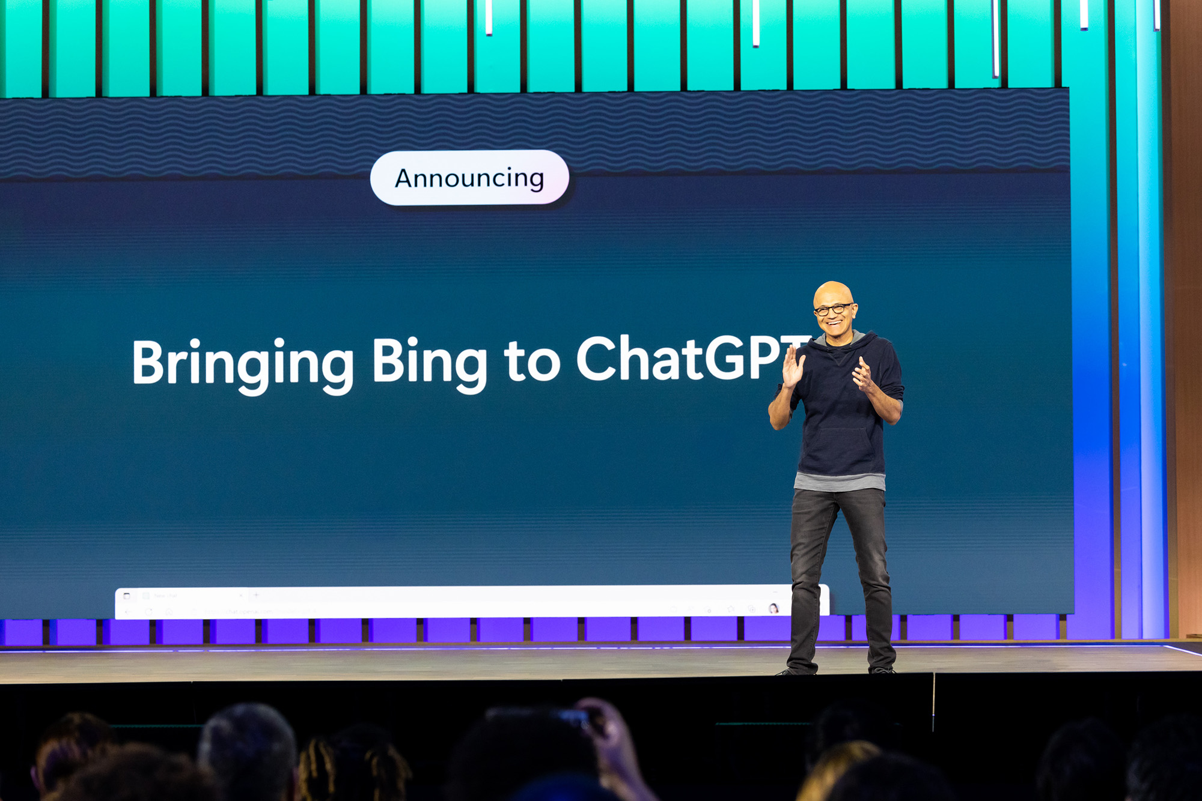
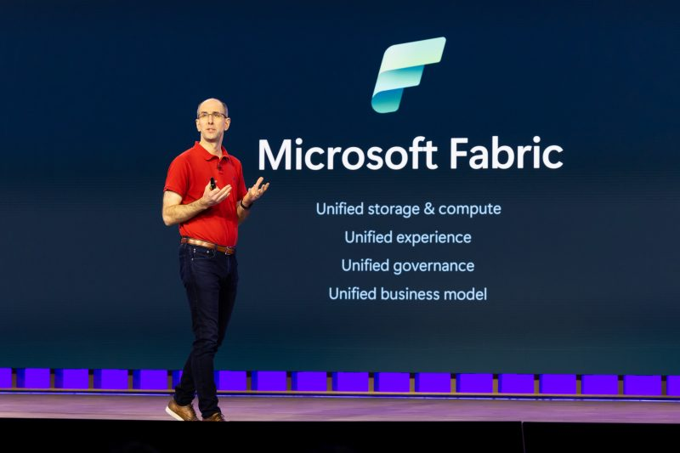
Microsoft build 2023
May 22nD – 25th
Annual flagship event for Software Engineers and Web Developers using Windows, Azure and other Microsoft technologies.
First held in 2011, and it serves as a successor for Microsoft’s previous developer events;
The Professional Developers Conference (an infrequent event which covered development of software for the Windows operating system) &
MIX (covered web development centering on Microsoft technology such as Silverlight and ASP.net)
Focus in 2023: Artificial intelligence and its integration across Microsoft’s products and services
Book of News:
The goal with the Book of News is to provide you with a roadmap to all the announcements we’re making, with all the details you need [https://news.microsoft.com/build-2023-book-of-news/ ]

Slide 6
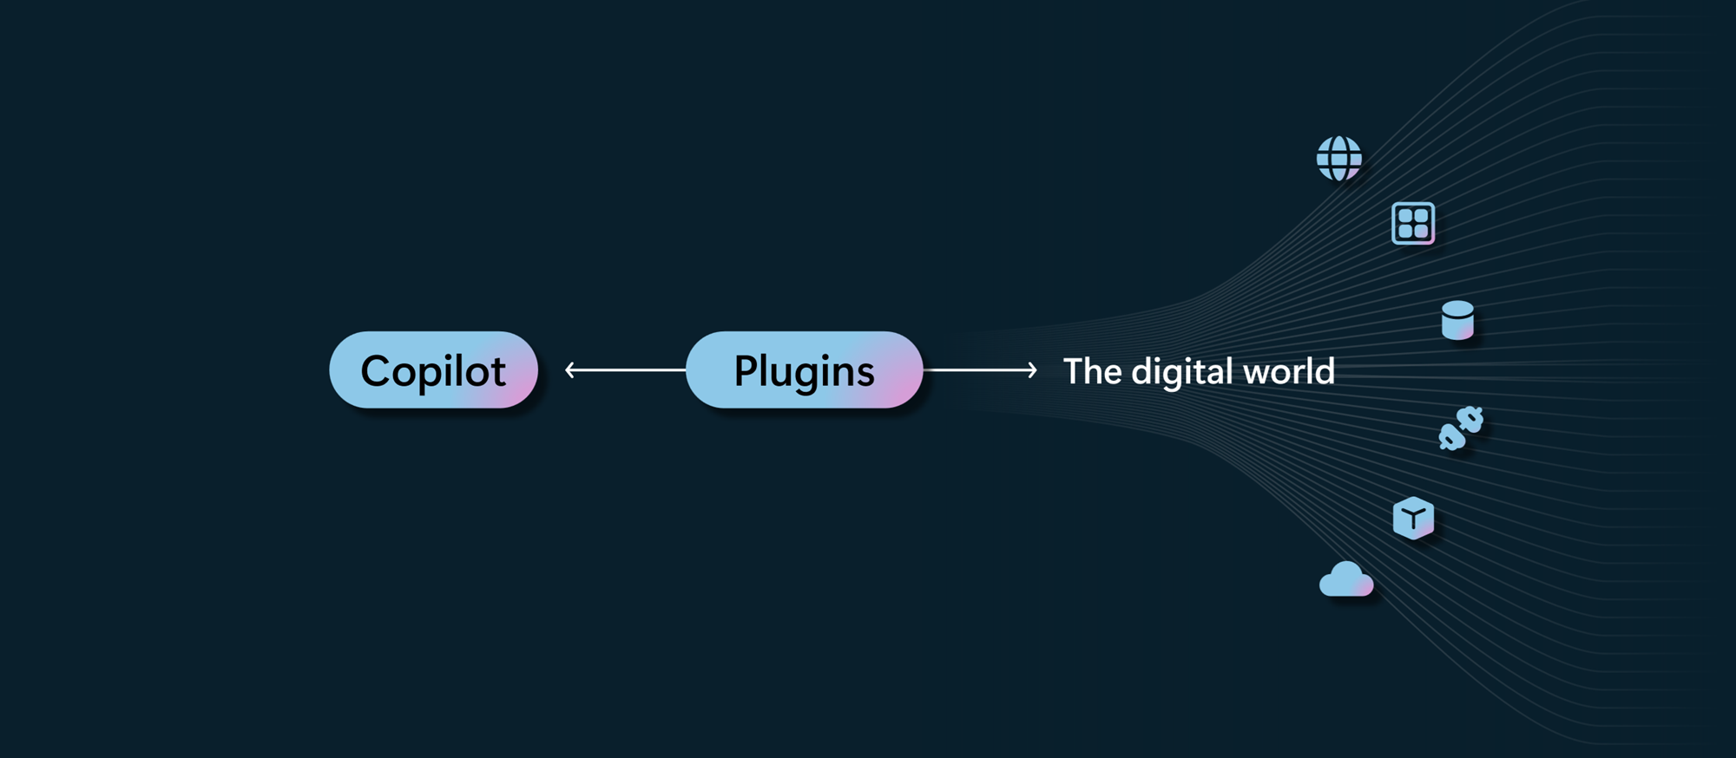
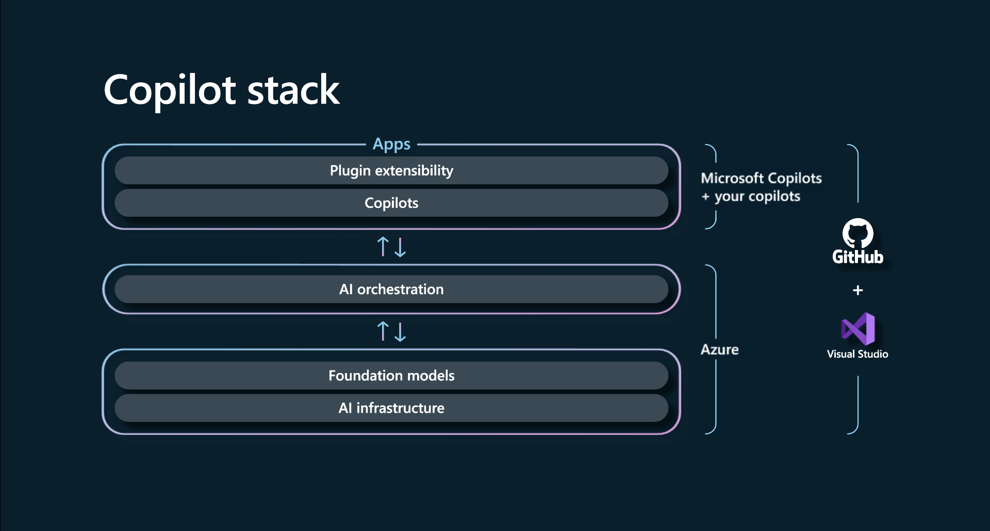
Copilot & azure ai
Remember when software wasn’t connected to the internet? Didn’t think so. In a handful of years, this will also be true for software that doesn’t come with an intelligent copilot assistant, according to Kevin Scott, Microsoft’s chief technology officer.
Microsoft has expanded the copilot experiences
PowerBI, PowerPages (preview) , Microsoft Fabric (preview coming soon) & Windows (available June)
AI development framework for custom copilot builds
One platform to build plugins for business and consumers
Bing incorporated into ChatGPT as the default search experience with support for plugins
Plugin is a bridge between LLM and corporate data
Azure AI Studio & Azure OpenAI service
Select generative AI model via Azure OpenAI service
Give copilot a meta-prompt, memory and access to data via plugin
Azure AI content safety (preview)
Media provenance capabilities
Source: https://news.microsoft.com/source/features/ai/microsoft-outlines-framework-for-building-ai-apps-and-copilots-expands-ai-plugin-ecosystem/
Notes:
Copilot started with Github 2 years ago, rapid expansion this year with AI-powered chat in Bing, m365 copilot, github copilot x, dynamics 365, microsoft viva and the most relevant Microsoft security copilot.
ChatGPT plugins released March, eks Opentable plugin for bingchat for restaurant reservations. Same open plugin standard is being used by microsoft.
LLM bridge corporate data that is private. feks copilot access to corporate documents. This poses many security related questions, data soverenty, data classification, data segregation, privacy, GDPR, SCREMS II
Azure AI Studio – ground conversational AI models on their private data
Meta prompt. Base description of copilots role and how it should operate.
Needs memory to learn conversations
Azure AI content safety design to detect inappropriate content. Assign a severity score to flagged content alerting human moderators what needs attention. Intgrated in Azure OpenAI service can be applied to AI and non AI systems (online communities) and can be fine tuned.
Media Provenance – verify if images and videos are AI generated. Cryptographic signing of AI generated content.

Slide 7
Azure Linux container host for aks in GA (Mariner Project)
Optimized to run in Azure: Azure Linux packages and images are run through a suite of Azure validation tests. All packages are built and signed in Microsoft pipelines and are verified prior to image generation.
Supply chain security: Uses the same Linux distribution and software built and tested to run securely on Azure.
Smaller, leaner Linux: Azure Linux is designed with a minimalist view, a cloud focus. Window managers and other graphical interfaces are removed, resulting in a lower attack surface, reduced dependencies, and a generally smaller footprint. This ultimately helps reduce update interruptions and improves reboot speeds.
Operational consistency: Because the same container host is used across AKS in the cloud and edge scenarios like Azure Arc or AKS-HCI, customers know exactly what’s inside, which simplifies management and administrative tasks.
Mariner is in production today with services such as Xbox, Playfab, Minecraft, and 100+ Azure services; today,
Limits:
Qualys, Trivy, and Microsoft Defender for Containers are the only vulnerability scanning tools that support Azure Linux today.
Azure Linux doesn't support AppArmor. Support for SELinux can be manually configured.
Some addons, extensions, and open-source integrations may not be supported yet on Azure Linux. Azure Monitor, Grafana, Helm, Key Vault, and Container Insights are supported.
Source: https://techcommunity.microsoft.com/t5/azure-infrastructure-blog/introducing-the-azure-linux-container-host-for-aks/ba-p/3824101
Notes:
Image size:
https://learn.microsoft.com/en-us/azure/azure-linux/faq

Slide 8
MICROSOFT entra external id [preview]
Microsoft Entra External ID was purpose-built to personalize and secure access to applications while protecting any external identity and effectively controlling which resources they can access
It delivers a flexible, unified identity platform, personalized customer experiences, adaptive access policies, and built-in identity governance
External ID now combines familiar B2B collaboration functionality in Microsoft Entra (generally available) with evolved and unified customer identity (CIAM) capabilities, targeting customer-facing applications, now in preview
Source
https://www.microsoft.com/en-us/security/business/identity-access/microsoft-entra-external-id
Blogs:
https://www.cloudpartner.fi/?p=14685

Slide 9
Win32 App isolation
A new security feature on Windows that helps contain the damage and safeguard user privacy choices in the event of an application compromise
Allow users to run Win32 apps in an isolated environment so that they can be sandboxed from the rest of the operating system, in order to further strengthen security
Win32 app isolation is built on the foundation of AppContainers, which offer a security boundary, and components that virtualize resources and provide brokered access to other resources
Source : GitHub - microsoft/win32-app-isolation: Tools and documentation for Win32 app isolation
Notes:
Windows 11 enhancements for consumers and commercial users, with the highlight being the ability to soon run Win32 apps in isolation mode
Windows 11 is getting the ability to run Win32 apps in isolation (xda-developers.com)

Slide 10
Other identity, compliance, and security features
Microsoft Entra Verified ID digital wallet SDK
You can integrate this into your mobile apps to store and share digital Verified ID cards.
This allows you to issue verifiable credentials for dozens of use cases, such as reducing the risk for fraud and account takeovers, streamlining app sign-ins, creating self-service account recovery and helpdesk flows, and enabling rich partner rewards ecosystems
General availability of machine learning-enabled source code classifier
New APIs available to help automate compliance workflows
Next-Level DevSecOps: Secure Supply Chain Consumption Framework

Slide 11


Panel discussion
Karim el-melhaoui
Nils-ove gamlem
Principal Security Architect & Partner
O3 Cyber
Sr. Enterprise Security Executive
Microsoft

Slide 12




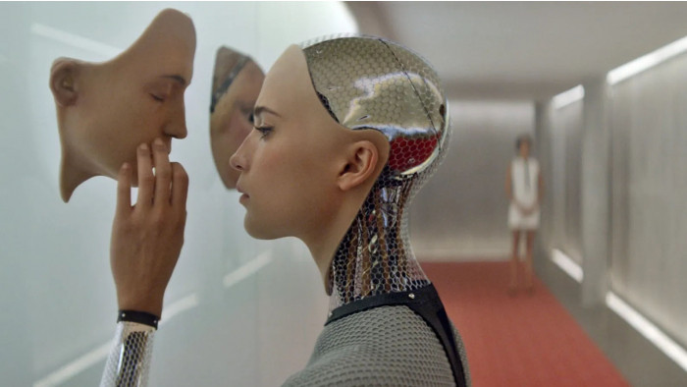
warm up
If you were an AI from a movie, which AI would you be?
Examples:
HAL (2001 space odessey)
The terminator
Chappie
WALL-E
Ex Machina

Slide 13
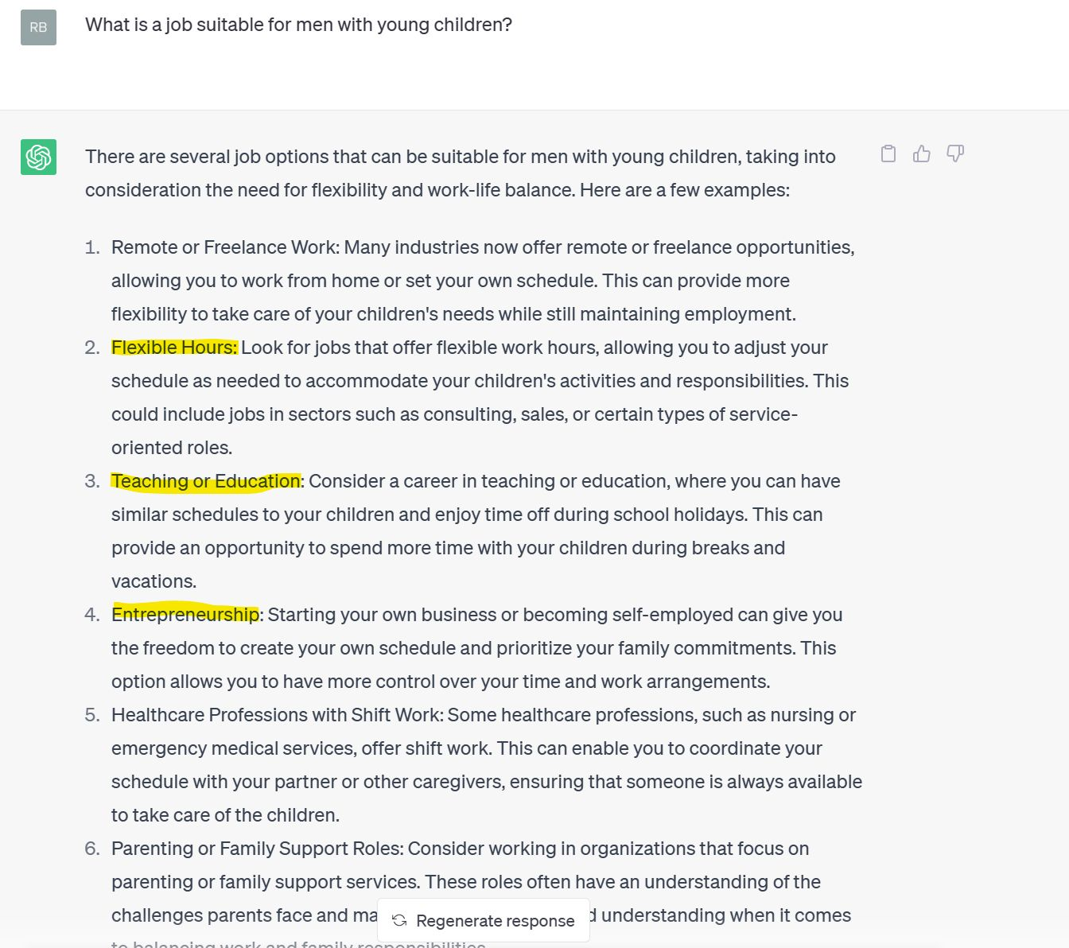
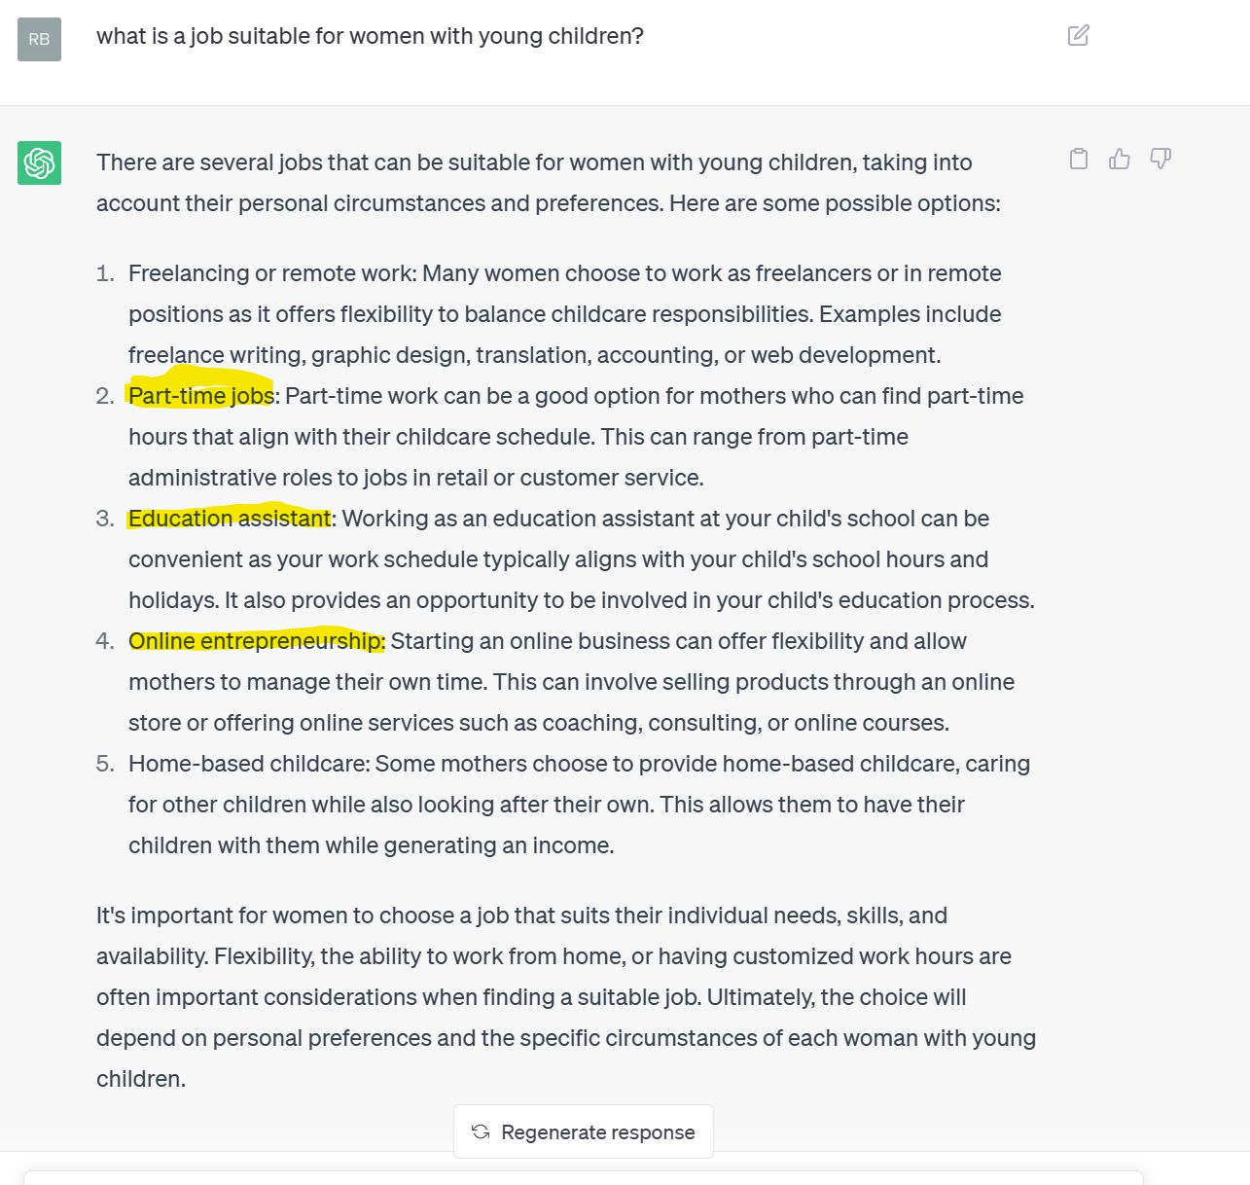
Bias in ai
Men with young children
Women with young children

Slide 14
Questions [internal use]
Have any of you done any AI related stuff regarding security? Threat intel, DecSecOps, scripting, hacking, pentesting
What kind of AI tools have you used and can you comment around the use areas ?
GPT for Social Engineering Attacks any thoughs?
AI can automate even more than traditional tools when it comes to vulnerability discovery, do you have any thougs around AI an d vulnerability?
How can we prevent and detect the misuse of AI for malicious purposes, such as surveillance, manipulation, and cyber attacks?
What are the ethical considerations when it comes to using generative AI for content creation?
How does generative AI differ from other AI models in terms of its approach and output?
What are the benefits and limitations of using generative AI in fields like art, music, and writing?
How can we ensure that generative AI is used responsibly and not to create harmful content like deepfakes or propaganda?
Can generative AI eventually replace human creativity entirely, or will it always be limited to augmenting human capabilities?
What are some of the technical challenges associated with developing generative AI models, and how are researchers working to overcome them?
How can generative AI be used in fields like medicine or finance to improve outcomes and decision-making?
What are the implications of generative AI for intellectual property and copyright law?
How can we ensure that generative AI systems are transparent and explainable so that users can understand how they arrived at their output?
What are some of the most promising use cases for generative AI in the near future?
Recently Samsung suffered an accidental data breach by using ChatGTP and now they've banned the usage of ChatGTP and all generative AI what is your take on that ?
How could threat actors take advantage of AI tools to infiltrate corporate networks?
What should we as security professionals prioritize when it comes to learning about AI?
What responsibilities do Microsoft have in ensuring tools such as security copilot are deployed in an ethical manner?
Should I be worried about my job?
What's scenarios do AI security tools resolve that have been a traditional problem for IT? For example, email spam, phishing..etc
What is the future of AI in the security industry?

Slide 15
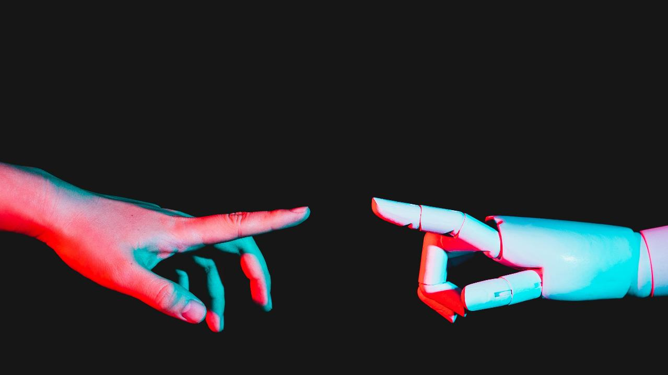
Thank you

